Slide 1
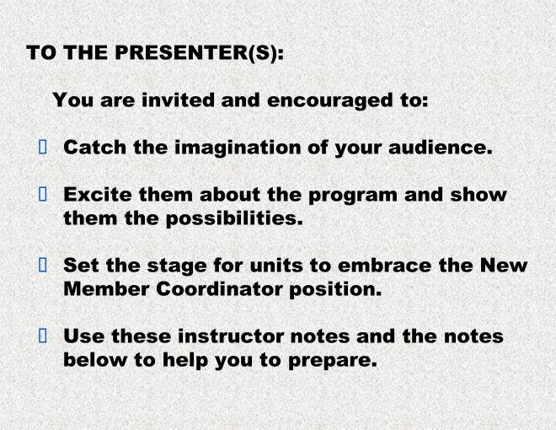
Notes:
[Slides #1 through #3 are for the presenters only. The presentation begins with slide #4 – the title slide.
[Do your best to make friendly, welcoming connections with the audience immediately and throughout the presentation. Be as interactive as possible, so that participants are engaged in thinking about how the ideas resonate for them personally.
Use the notes at the bottom of slides to guide you. Information in italics and/or brackets [like this] is for you alone. Suggestions for what you will say are in regular type rather than italicized or in brackets.

Slide 2
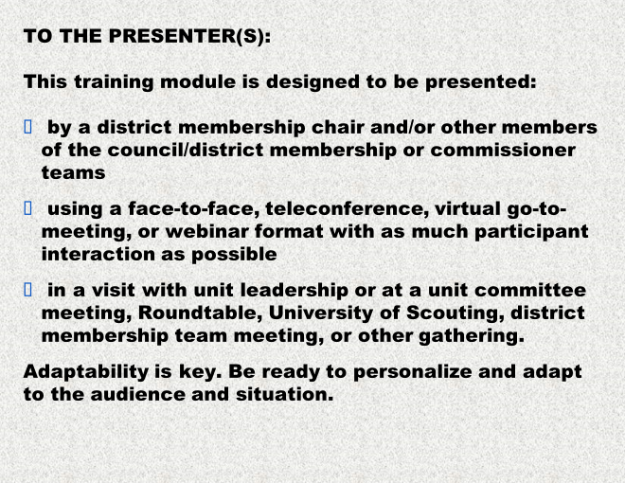
Notes:
[Slides #1 through #3 are for the presenters only. The presentation begins with slide #4 – the title slide.]
Remember that your enthusiasm and energy will be contagious. Please keep reminding yourself that you are setting the stage for units to embrace membership growth through New Member Coordinators.
Move quickly through the slides. Many are designed for quick visual impact and do not require discussion. Tailor your overall timing to the situation.
If you are a member of the local district, please prepare for a continuing role mentoring and supporting New Member Coordinators and their units. Learn from the online training for New Member Coordinators on the e-learning site, and be sure to take the district membership team supporting the NMC. ]

Slide 3
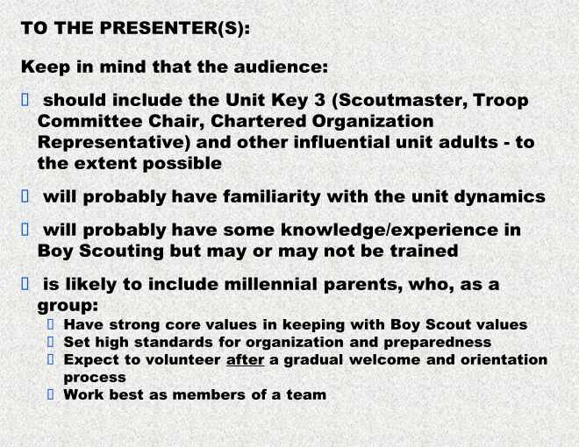
Notes:
[Slides #1 through #3 are for the presenters only. The presentation begins with slide #4 – the title slide.
Show the members of the audience that they are valued. Help them to feel a sense of belonging. We are all part of an inclusive community, and our demographic differences make us stronger as a group. This idea should be communicated through our welcoming attitude even more than through what we actually say.]

Slide 4

Notes:
PRESENTERS: In a group presentation setting, please use this slide as the “screenshot” showing in the room while everyone is gathering.
Establish the feeling of belonging immediately – through hospitality, greetings, and introductions, to the extent possible in the setting. Set the scene for friendly, helpful discussion and sharing of ideas.
If sharing with just one individual, such as a unit Committee Chair, then start with the next slide.

Slide 5

Notes:
WHAT IF … there were a way to make your life easier as a leader ….. And strengthen your pack at the same time ….
WHAT IF … it wouldn’t be difficult to implement ….
WHAT IF … this new approach is INFORMAL, FLEXIBLE, ADAPTABLE TO YOUR PACK’s SPECIFIC NEEDS and your parents’ SPECIFIC INTERESTS ….
Would you like to know more?

Slide 6
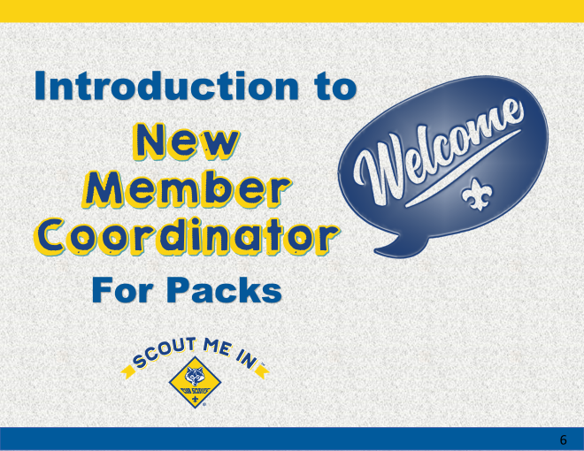
Notes:
There is a new idea for units which IS easy to implement and can make a world of difference to your unit, and it’s called the NEW MEMBER COORDINATOR.

Slide 7
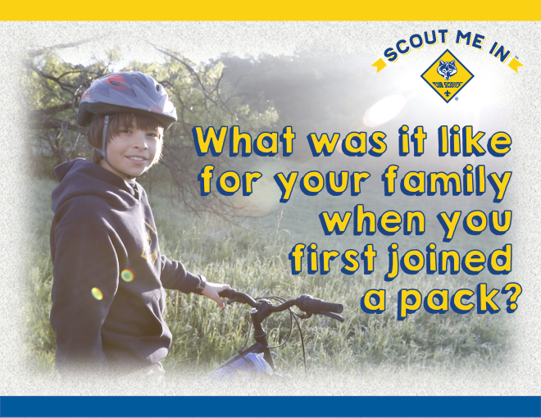
Notes:
Let’s begin by thinking back to the days when you first joined a Cub Scout pack.

Slide 8

Notes:
I bet there was plenty of excitement, but also a bit of confusion, too. Maybe you were unsure Scouting was right for YOUR family. Did you have any of these feelings? Me, too. I imagine every family feels that way at the beginning. There is so much going on, and so much to learn.

Slide 9

Notes:
What are the typical questions and concerns a new family would experience when joining Cub Scouts? Especially if the parents didn’t grow up in Scouting?
(With an interactive, fact-to-face presentation, ask for audience ideas. Write responses on chart paper or have a volunteer write on the chart paper.)
Now that you have been part of a pack for a while, what have you seen that helps you identify the concerns new youth and families may have about joining Scouting?

Slide 10

Notes:
What makes the difference in those FIRST FEW WEEKS IN THE Pack and Den? What sort of things make families bond with Scouting? What are the things that cause them to leave?
(With an interactive, face-to-face presentation, lead a discussion on what does make the difference during the first weeks of a youth joining Cub Scouts. Have someone list the feedback on chart paper. With a larger group, put participants into smaller groups and have them create a list of what makes the difference in those first weeks and let each group present their thoughts. With a very large group and /or a more formal presentation, announce that this a pause for reflection and suggest that participants write down some ideas.)

Slide 11

Notes:
Please shout out some key benefits. [Gather key ideas and quickly summarize.] Scouting helps boys and girls have fun, learn life-long skills, and build lasting friendships. Recently, we’ve seen research evidence that being a Scout makes significant difference in character and leadership development.

Slide 12
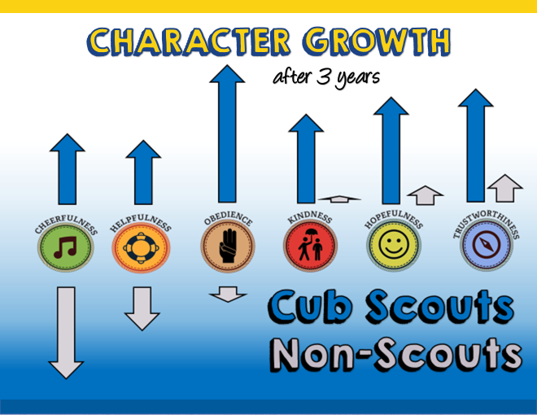
Notes:
The Tufts Study showed that, over 3 years, Cub Scouts (blue arrows) developed positive qualities like trustworthiness and helpfulness in contrast to non-Scouts (light grey arrows). There was no statistical difference in character traits for the two groups when the study began. I think it’s particularly interesting to see how cheerfulness (first column) declined dramatically for other boys but not for Cub Scouts.
[The Tufts Study measured 11 character attributes in 3,000 Scouts and 1,000 non-Scouts over 3 years. After 3 years, significant increases in cheerfulness, helpfulness, kindness, trustworthiness, and hopeful future expectations were reported for Scouts. Among non-Scouts, those character traits declined.]

Slide 13

Notes:
[Read and move quickly to next slide]

Slide 14

Notes:
[Read and move quickly to next slide]

Slide 15
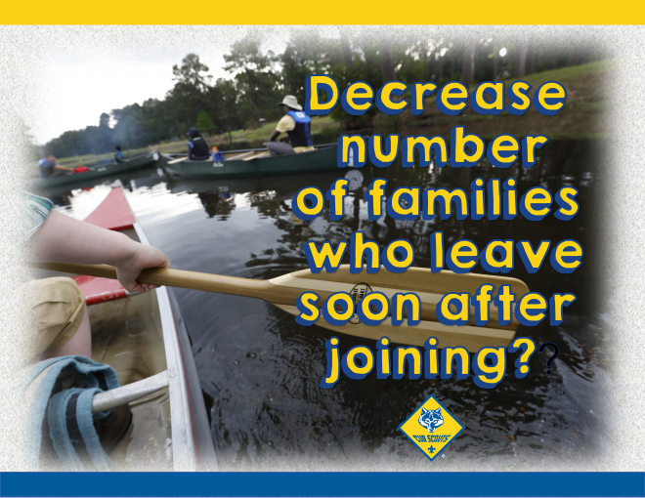
Notes:
[Read and move quickly to next slide]

Slide 16
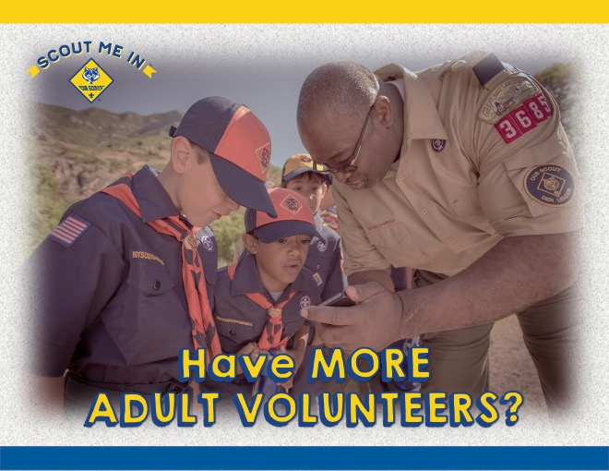
Notes:
[Read and move quickly to next slide]

Slide 17

Notes:
If you answered YES to any of these …

Slide 18
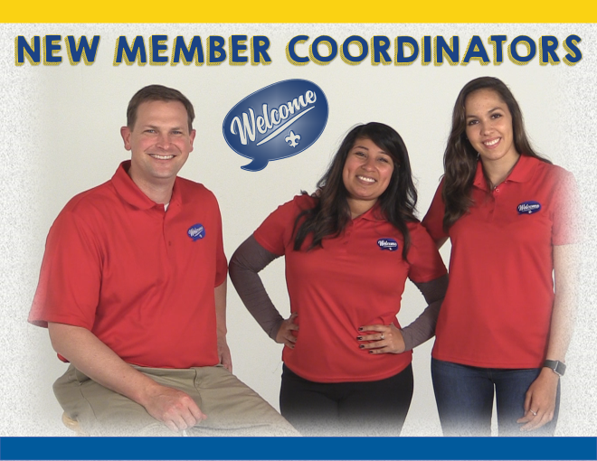
Notes:
Then a NEW MEMBER COORDINATOR is for you!

Slide 19
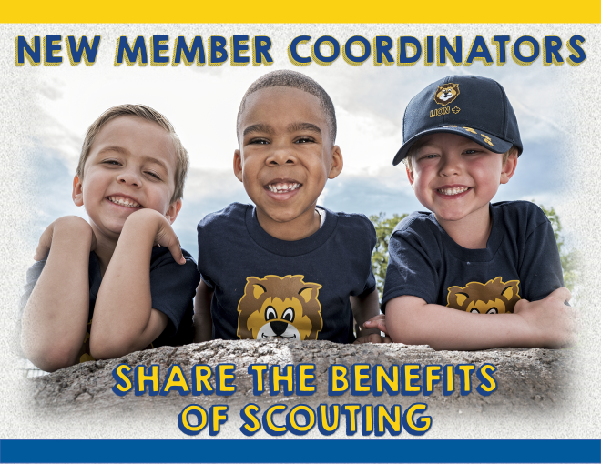
Notes:
They tell the story of why Cub Scouting is a worthwhile and valuable activity for boys and girls, along with their families. What have you personally seen that convinces you of the value of the Scouting? Those are the kinds of messages that New Member Coordinators share – on social media and in person.

Slide 20
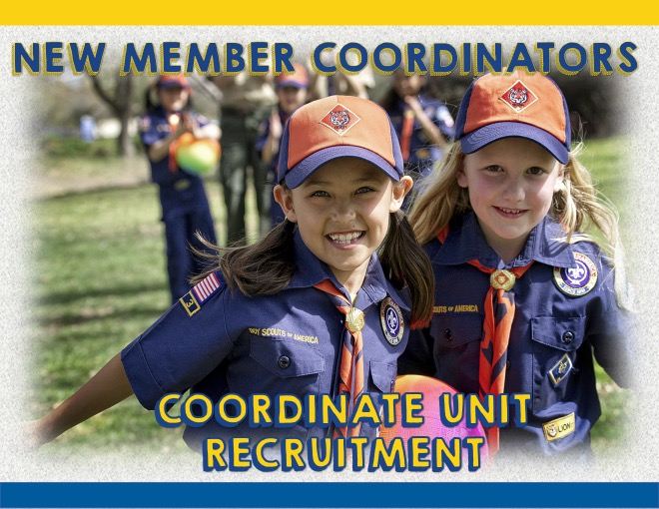
Notes:
They help unit leadership with membership activities and events.

Slide 21
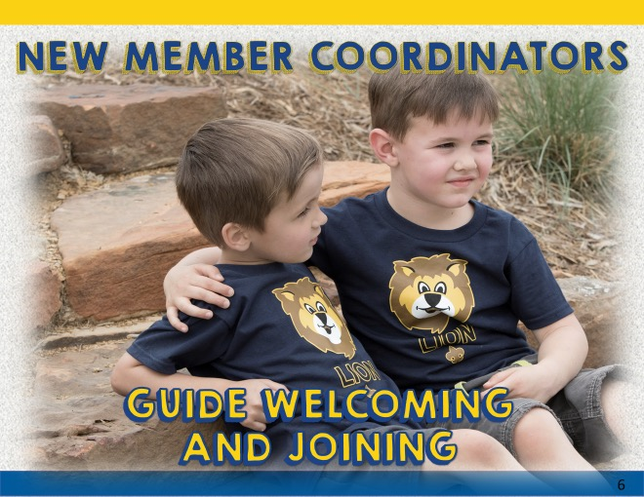
Notes:
They assist new families to make them feel welcome and comfortable in their new Scouting family.

Slide 22
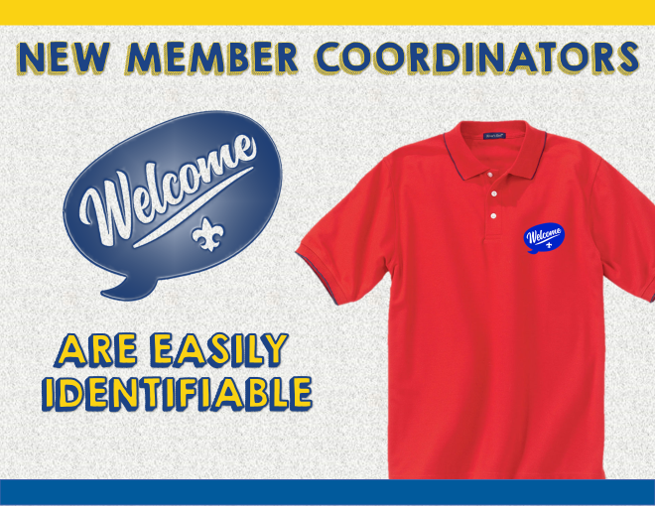
Notes:
With this new logo on their shirts, New Member Coordinators are easily identifiable to all guests and new families. They stand out from the crowd of leaders in their uniform shirts. Your unit can choose how to identify your New Member Coordinators and how the logo is worn – polo or t-shirt, and pick your color.

Slide 23
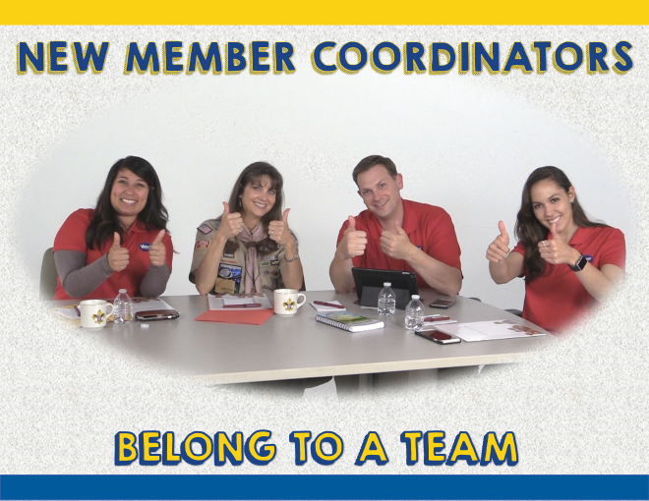
Notes:
More than one person can be a New Member Coordinator, and the position is specifically designed for a team approach. Multiple people can be registered for this position. Teams allow more people to contribute and take ownership of the goals and planning.

Slide 24
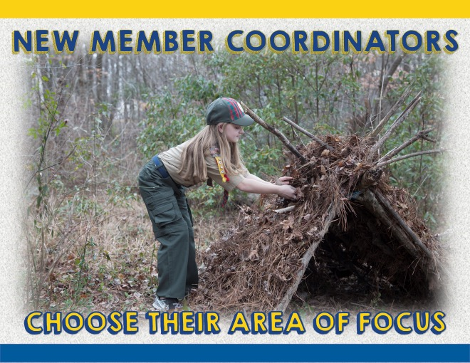
Notes:
Teams also allow each person to pick their area of focus – to do those aspects of the role that appeal to them personally and suit their skill set, talents and personality. Just as a baseball team has a pitcher and a catcher and fielders who each do different jobs, so it can be with the New Member Coordinator Team.
Besides that, clearly many hands make light work, and being involved is more appealing when you have others working with you to accomplish the goal.

Slide 25
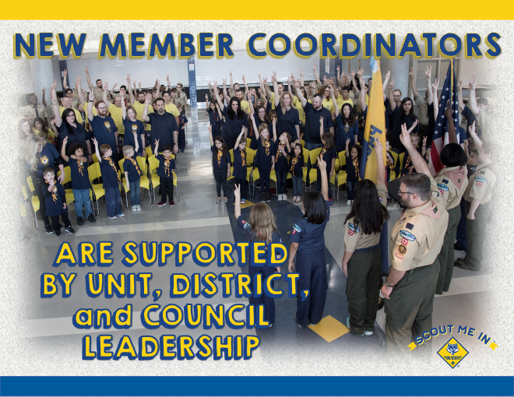
Notes:
New Member Coordinators don’t have to “go it alone.” They have the support of their unit, district and council leadership. Training is available, and easily accessible. Council level support in terms of print materials, social media campaigns and other ideas for annual recruiting drives give the unit and the NMC team ready made resources. The District Committee and the District Membership Chair are available as well for training, coaching and mentoring.

Slide 26

Notes:
Who in your pack might be just right for this position?

Slide 27

Notes:
Sounds great so far, but how do you find the “right” person or persons for the New Member Coordinator team? What sorts of characteristics should you look for?

Slide 28

Notes:
A good candidate for this position is someone who is at ease with meeting and talking to new people. Who is outgoing and friendly, who always has a smile.. Who is HELPFUL. FRIENDLY, COURTEOUS and KIND, just like the Scout Law.

Slide 29
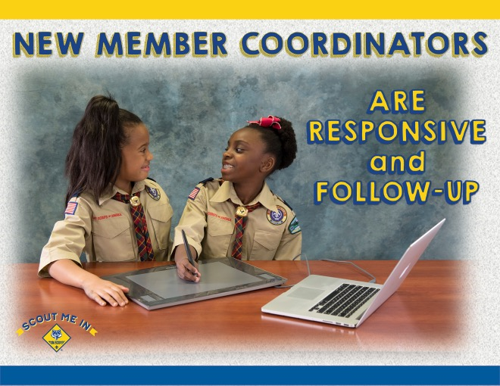
Notes:
A good candidate for this position is someone who is at caring and responsive, someone who is good with follow-up. New families have lots of questions, and the New Member Coordinator needs to be available as a continuing point of contact after they join, willing to check in with the new members and see how they are doing, and answer questions as they arise.

Slide 30
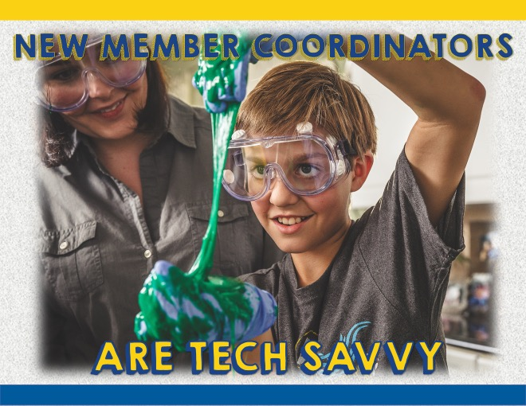
Notes:
A good candidate for this position is someone who is tech savvy … Facebook, Twitter, Instagram, you name it, they are “on” it. They enjoy using today’s technology to share moments and memories, to invite others to join in, and to stay connected with family and friends.

Slide 31
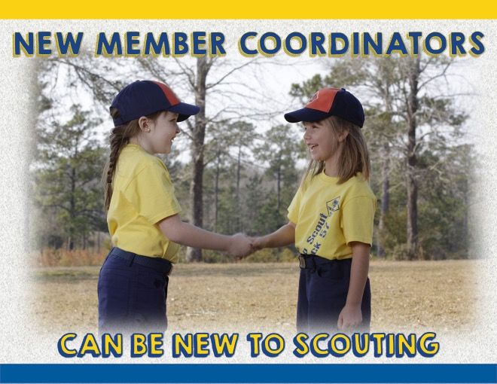
Notes:
While some experience with the Scouting program is a plus, it is NOT a prerequisite. The key here is enthusiasm. It’s contagious! A New Member Coordinator doesn’t need to know ALL the answers, but just be willing to find out and follow-up. After all, new families generally need to know the practicalities – where to meet, when, where to buy a uniform, how to place the patches … things like that.

Slide 32
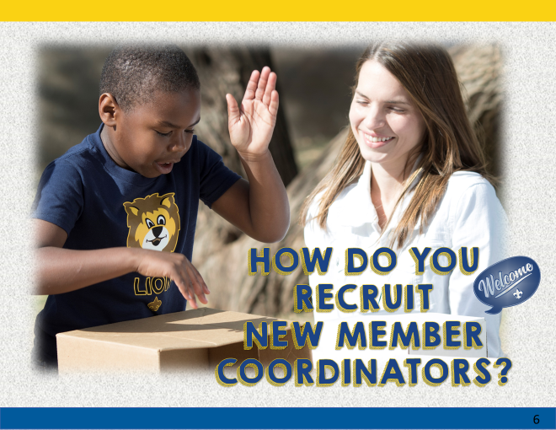
Notes:
It’s great if the key leadership of your pack can collaborate on the candidates and the approach you’ll use.

Slide 33

Notes:
Most parents of elementary school children are millennials - that is, they came of age in the year 2000 or later. Millennial parents are exactly what Scouting needs. They have strong values that mesh well with Scouting values, including wanting to help others. They are focused on being ”prepared” (sound familiar?). They bring a wealth of tech-savvy and team-building skills. And they’ve been volunteering all their lives!
That said, we welcome New Member Coordinators of any generation.

Slide 34
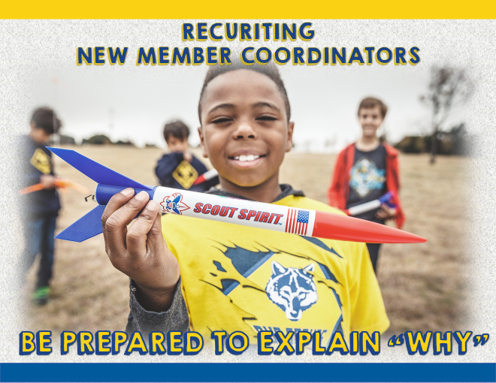
Notes:
There are two “why’s” you’ll need to explain:
WHY the role of New Member Coordinator is of critical importance to your Pack
WHY you believe your prospect has talents/skills/personality to be a good fit for the role. People like to have others express confidence in their ability to contribute.

Slide 35
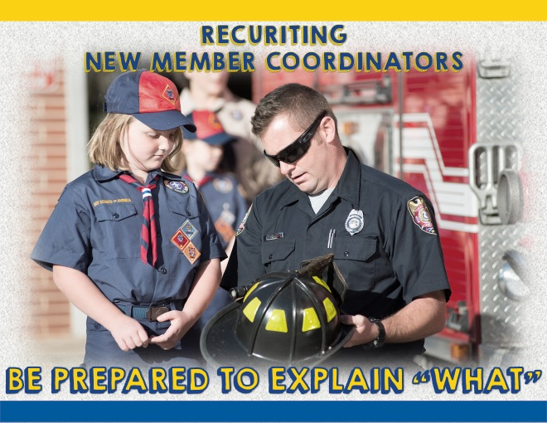
Notes:
After “why” comes “what” … what is a New Member Coordinator? What does he/she do? This is where you can explain the team concept of the position coupled with the different aspects of the role, which allow the volunteer to have choice on how they contribute.

Slide 36
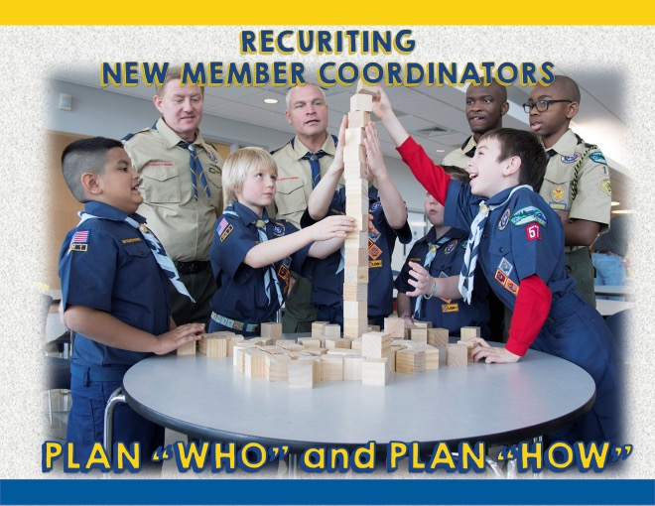
Notes:
You’ve identified your prospect(s) and prepared what you can say. Now you need to carefully select WHO is the best person to approach that individual. Usually, the Cubmaster or the Committee Chair would participate, but if there is someone else (a den leader or the Pack Trainer) who personally knows your candidate, they might be a good choice as well. Two people is often very effective.
However you approach your candidate, be sure to make it a personal invitation, and listen carefully to their response and any questions they might have. Remember that people choose to do things based on one of three reasons--fellowship, achievement and influence. If your "ask" includes all three of these, they will be more likely to say "yes".
Hopefully, they say yes, but if not, based on their response you may find out what sort of volunteer role they would like to do (for example, assisting on campouts).

Slide 37
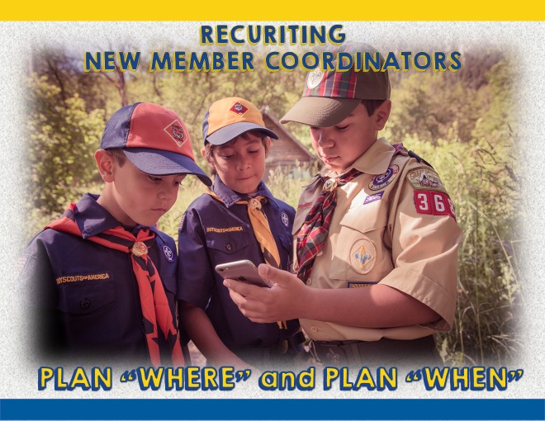
Notes:
Pick the best date/time and place. Right after a Pack meeting when everyone is trying to get home may not be a good time. Someplace where you can talk comfortably and with few interruptions would be a plus.

Slide 38
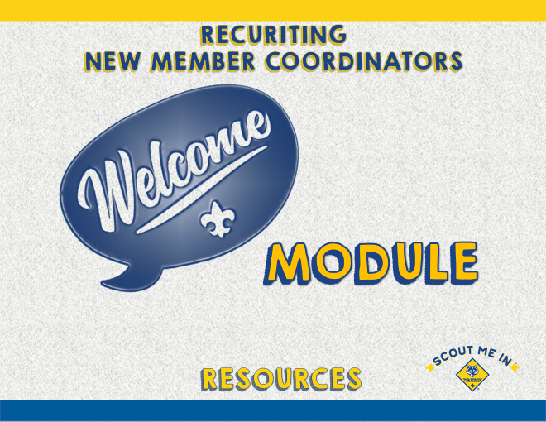
Notes:
One resource you can use when describing the New Member Coordinator role is the WELCOME Training Module (available online) . This course could be shared using a tablet or laptop, and you and your candidate could view it together. It explains the role of the New Member Coordinator and may be an effective “sales” tool for you.

Slide 39
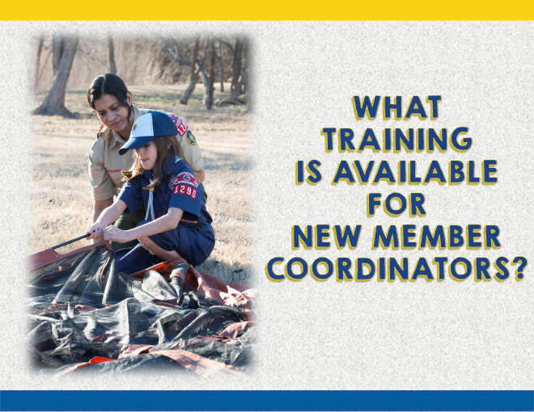
Notes:
Yes, position-specific training is available, and best of all, it is very manageable and easily accessed on-line through Scouting U. the BSA’s national on-line training site.

Slide 40
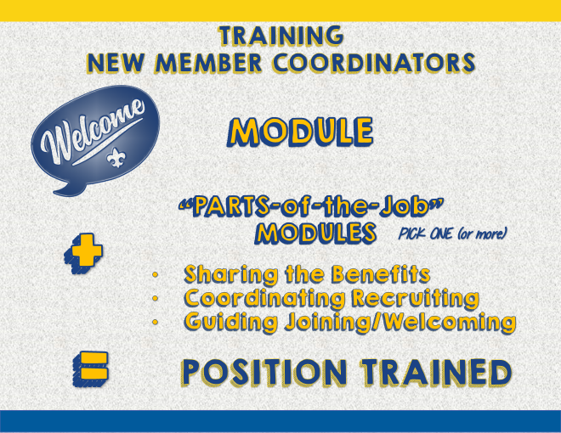
Notes:
The New Member Coordinator training is specifically designed to reflect the team concept for this position, and to be easily accomplished in a short period of time. Right now New Member Coordinators can take the first course. Eventually, to be considered trained, a volunteer will also need to take any one of the three “Parts-of-the-Job” modules: 1) Sharing the Benefits of Scouting, 2) Coordinating Recruiting, and 3) Guiding the Joining and Welcoming.
The website offers great resources, and additional materials are added often.

Slide 41
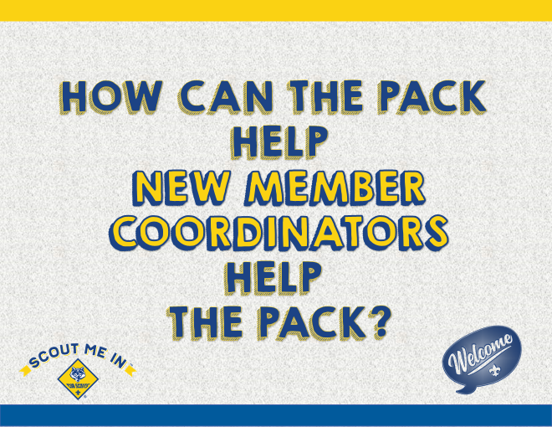
Notes:
[With an interactive, face-to-face presentation, this is the time to lead discussion. With a formal presentation mode, announce that this a pause for reflection and suggest that participants write down some ideas they have about how they can support New Member Coordinators and how supporting New Member Coordinators can help to strengthen the unit.]
[SUMMARIZE IDEAS.] Remember that the New Member Coordinators will be helping your pack to develop its membership plan, which is really just another way of saying HOW your pack will prepare to welcome new members and encourage them to feel a sense of belonging so that they will stay.

Slide 42

Notes:
It’s always more fun when you have a great team. MANY hands do make light work, and the New Member Coordinator TEAM position is designed to help make Scouting more enjoyable for all.

Slide 43
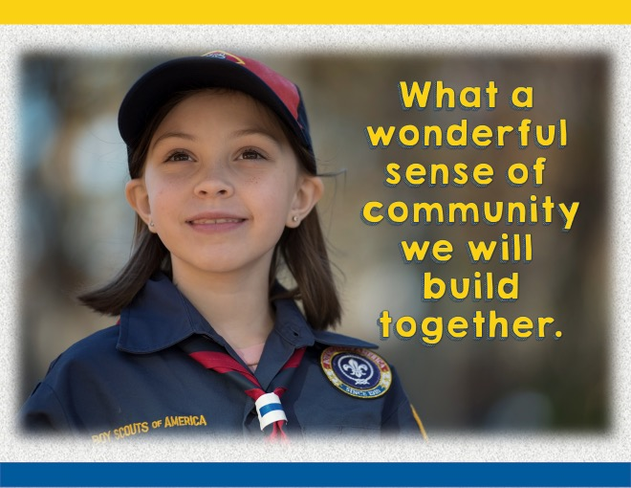
Notes:
[Read and move quickly to next slide]

Slide 44

Notes:
Insert contact information of presenter and/or others who will help support the unit and the New Member Coordinator.

